Slide 1
Master’s Project Proposal
Amy Woods
8/27/2021

Slide 2

Table of COntents
Problem/Motivation
Dataset, Audience, Goals
Related Works
Design
Conclusion

Slide 3
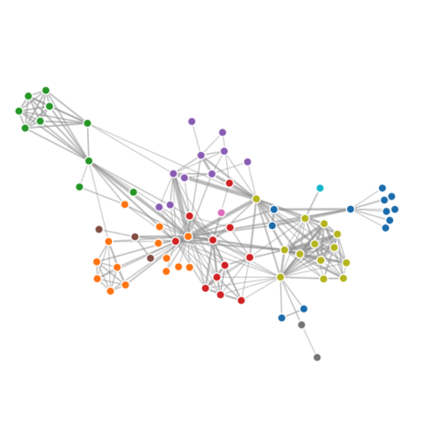
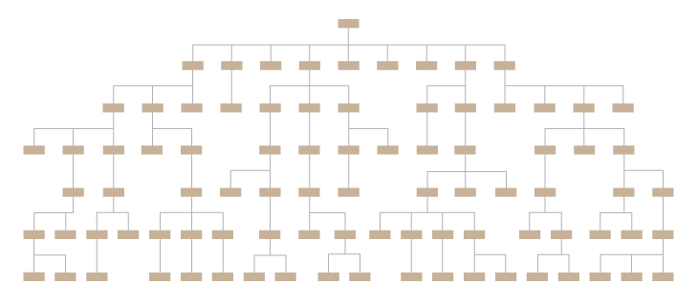
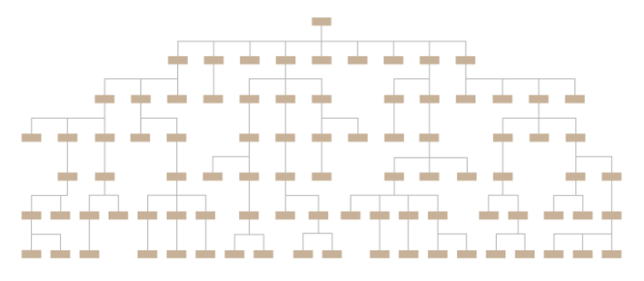
Problem/Motivation
Networks and Trees Research
Trees + Network Dataset
Set of trees
Network of intra and inter dependencies edges
Problem
Show intra and inter dependencies of a network while preserving the hierarchical component of the trees.

Slide 4
Sandia’s DataSet and Goals
Network + Tree Dataset
Functional Decomposition Trees
Intra/Inter Dependencies
Total Size: 55 Trees * YY Nodes per tree = YYYY max edges
Function
Sub Function1
Edge Type 2
Sub Function 2
Edge Type 1
Sub Function 1.1
Sub Function 1.2
Sub Function 2.1
Sub Function 1.2.1
Sub Function 1.2.2
Sub Function 1.2.3
Another Tree
Edge Type 1
Sub Function 3.4.1

Slide 5
Sandia’s DataSet and Goals
User’s Goal: Verify and Validate Dataset
How: Identifying Anomalies and Patterns
Function
Sub Function1
Sub Function 2
Problem/Goal
Design a data visualization application that not only visualizes both the hierarchical and network components of the unique dataset but also allows developers to verify and validate the dataset by detecting network and tree related anomalies or patterns.
Sub Function 1.1
Sub Function 1.2
Sub Function 2.1
Sub Function 1.2.1
Sub Function 1.2.2
Sub Function 1.2.3

Slide 6

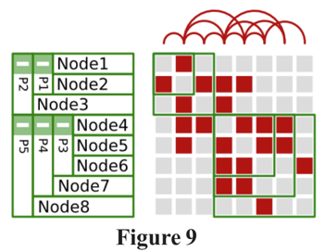
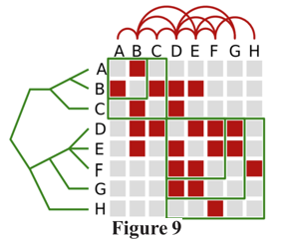
Related WorKs: Compound Graphs
Rufiange, Sébastien et al. “TreeMatrix: A Hybrid Visualization of Compound Graphs.” Computer Graphics Forum 31 (2012): n. pag.

Slide 7
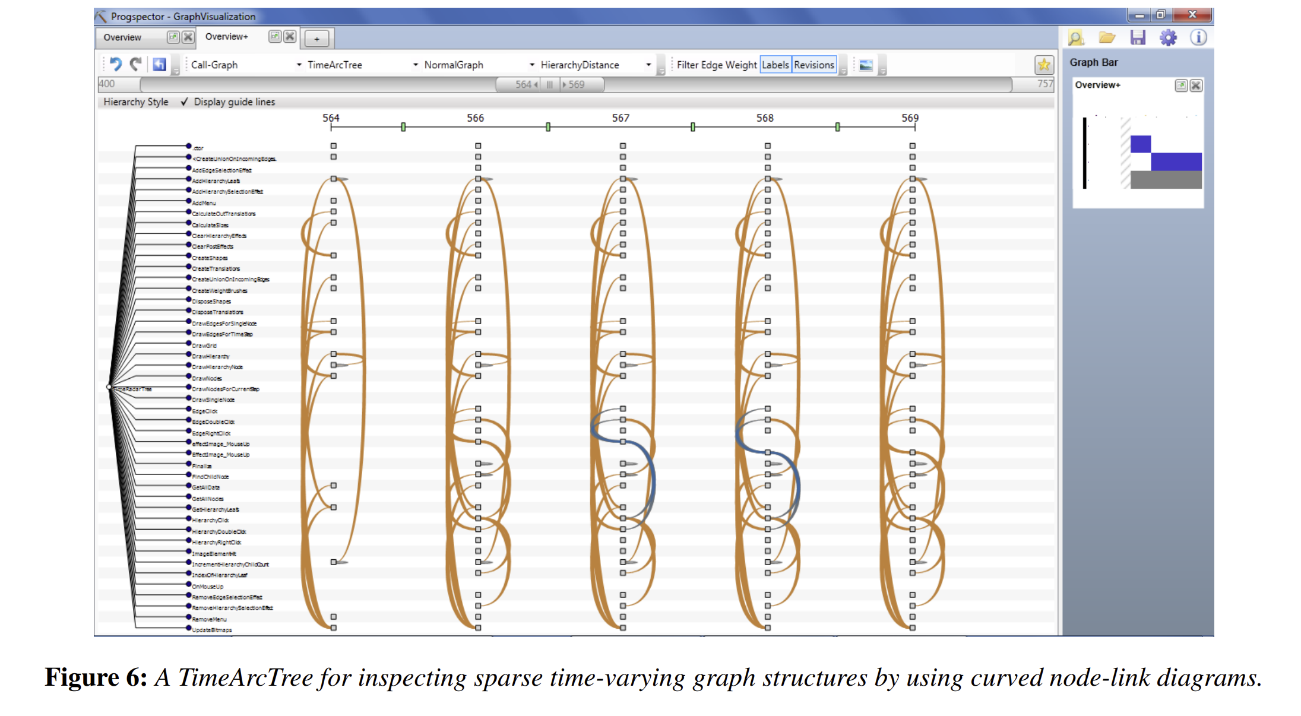
Related WorKs: Call Graphs
Burch, Michael & Müller, Christoph & Reina, Guido & Schmauder, Hansjörg & Greis, Miriam & Weiskopf, Daniel. (2012). Visualizing Dynamic Call Graphs. VMV 2012 - Vision, Modeling and Visualization. 207-214. 10.2312/PE/VMV/VMV12/207-214.

Slide 8
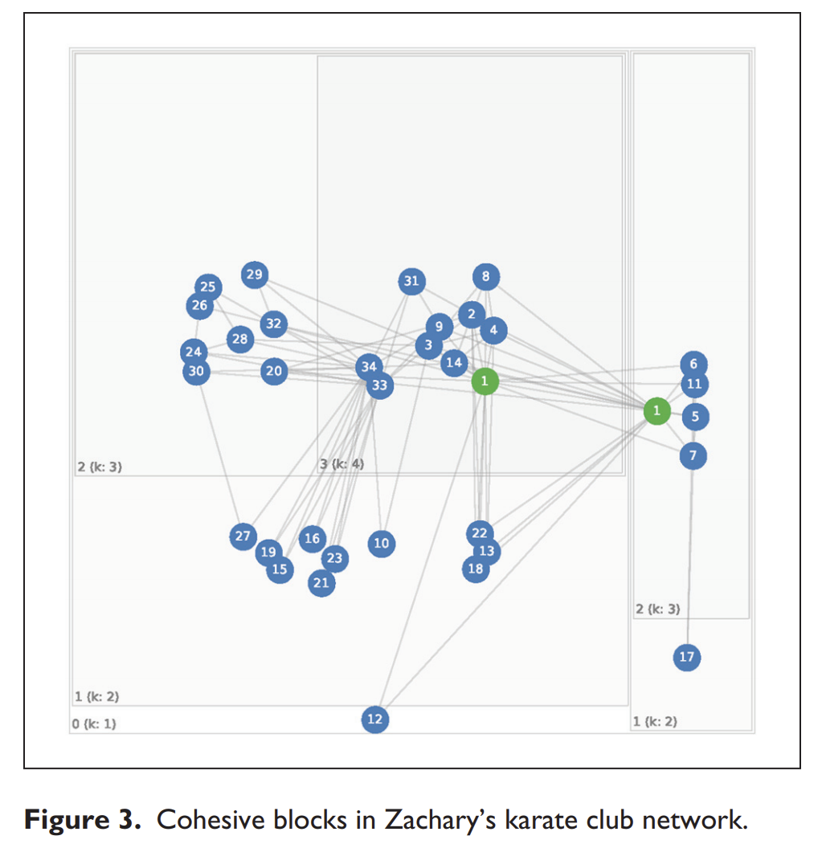
Related WorKs: Hierarchical Networks
Gemici K, Vashevko A. Visualizing Hierarchical Social Networks. Socius. January 2018. doi:10.1177/2378023118772982

Slide 9
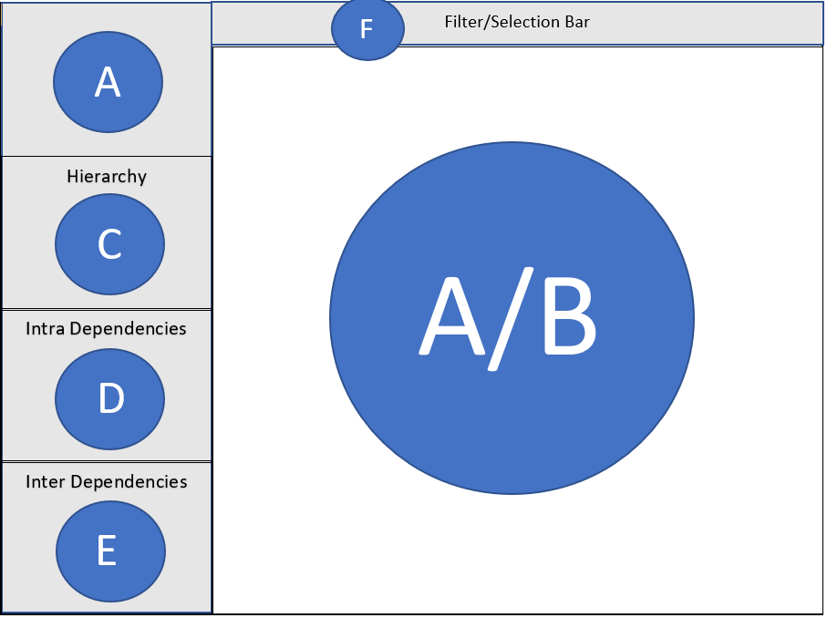
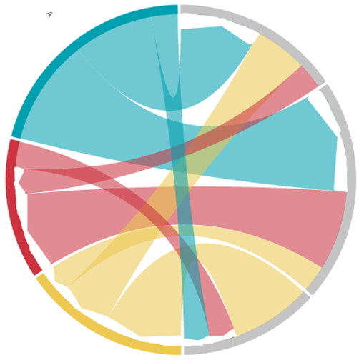
Design: Overall Layout
A: Overview Vis
B: Tree/Icicle Detail Vis
C: Mini Hierarchy Vis
D: Mini Intra Edges Vis
E: Mini Inter Edges Vis
F: Features/Tool Bar

Slide 10
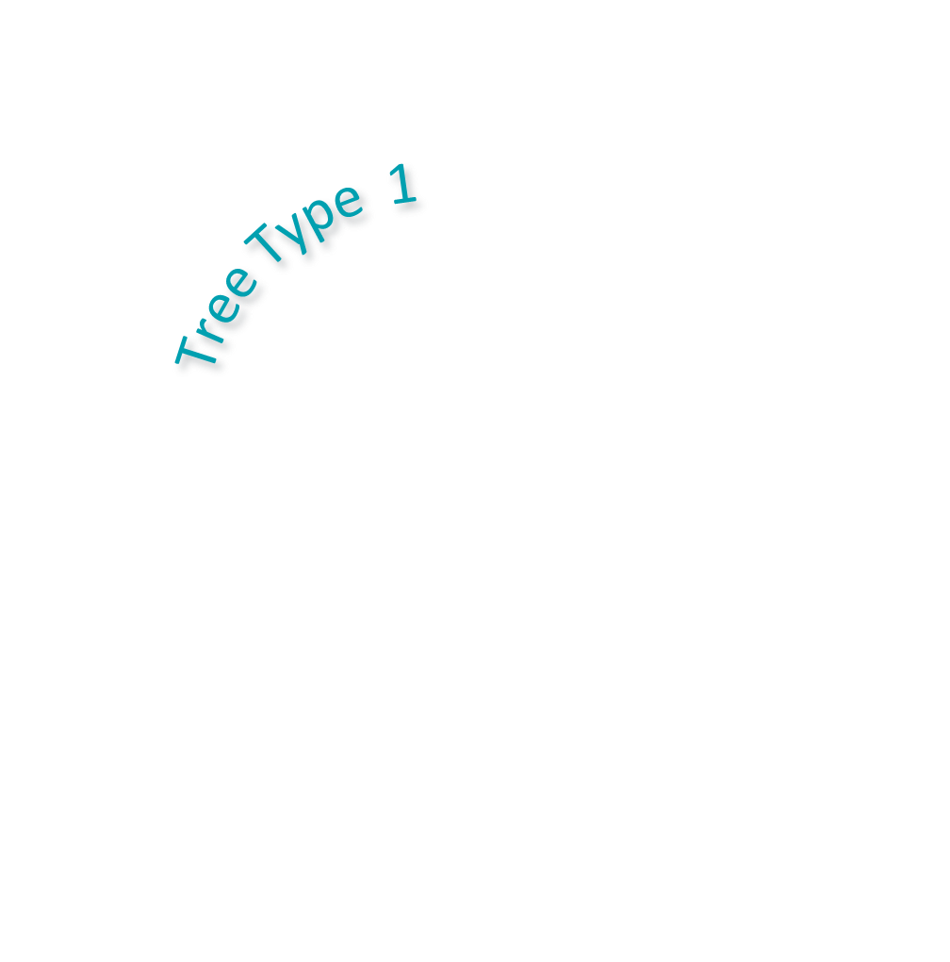


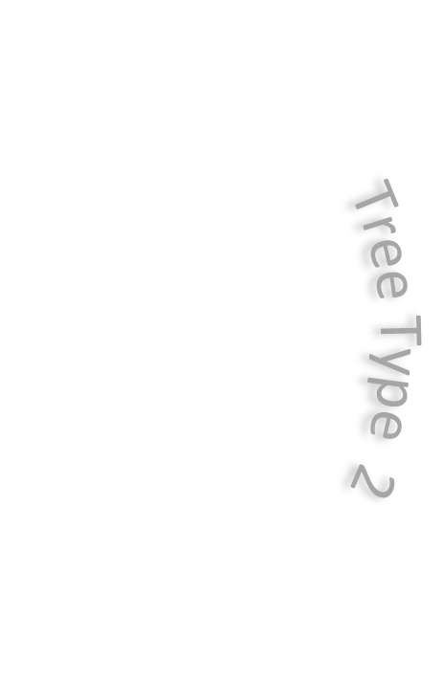
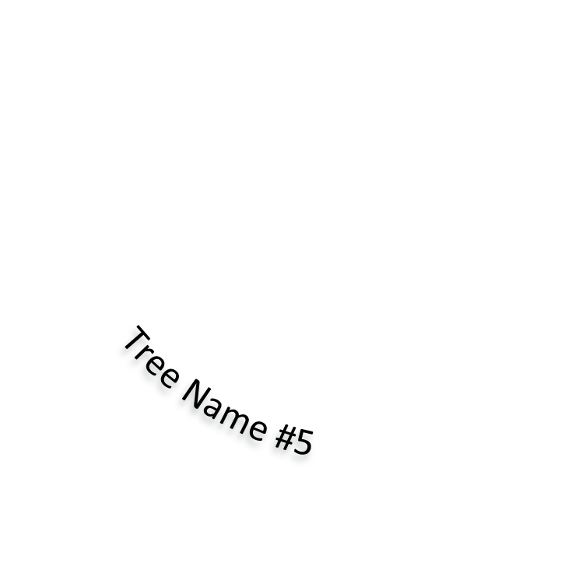
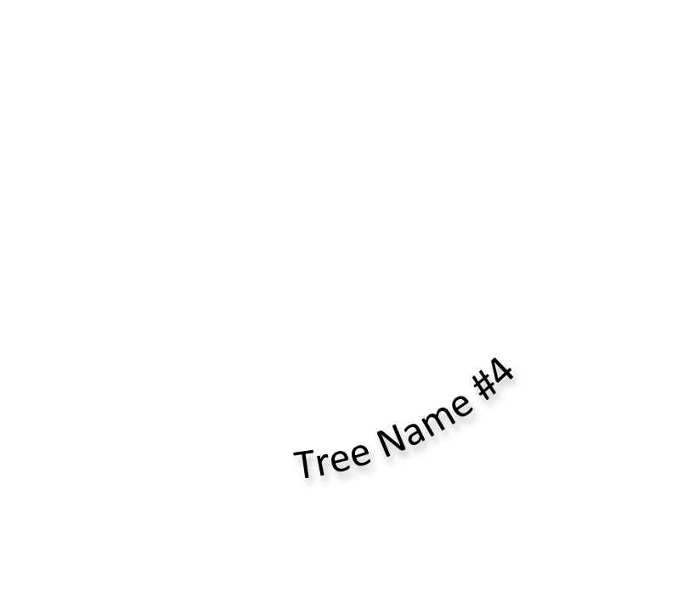

DeSign: Overview Vis
Filter/Selection Bar
Purpose/Goals
Summarize Network Data
Finding outliers or patterns
Incoming/Outgoing Edges
All trees of Tree Type X most intra connections
Provide Selection for Detailed View
Hierarchy
Tree Name #2
Tree Name #1
Tree Name #3
Tree Type 4
Tree Name #6
Intra Dependencies
Inter Dependencies

Slide 11
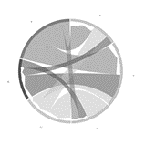
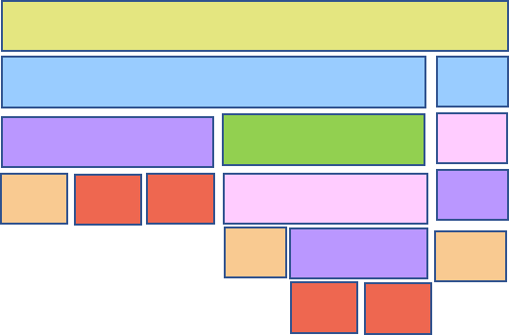
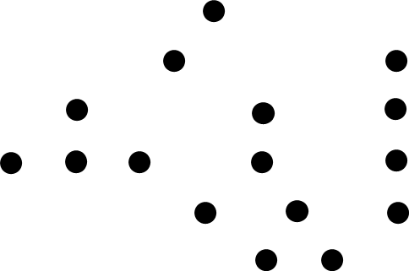


Design: Tree/Icicle Detail ViS
Purpose/Goals
Show and Preserve Hierarchy of Trees
Provide Detail View of Tree
Combined Tree/Icicle Vis
Color Hue = Node Type
Filter/Selection Bar
Hierarchy
Intra Dependencies
Tree/Icicle Algorithm
Minimize Leaf Block size
Center node in rectangle
Scale to Fit
Inter Dependencies

Slide 12
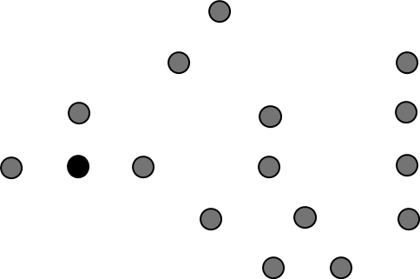


Design: Tree/Icicle Intra Edges
Purpose/Goals
Show Intra Edges
Preserve Hierarchy of Trees
Finding outliers or patterns
Node with most edges
Patterns of Node Type Connections
Filter/Selection Bar
Hierarchy
Intra Dependencies
Inter Dependencies

Slide 13
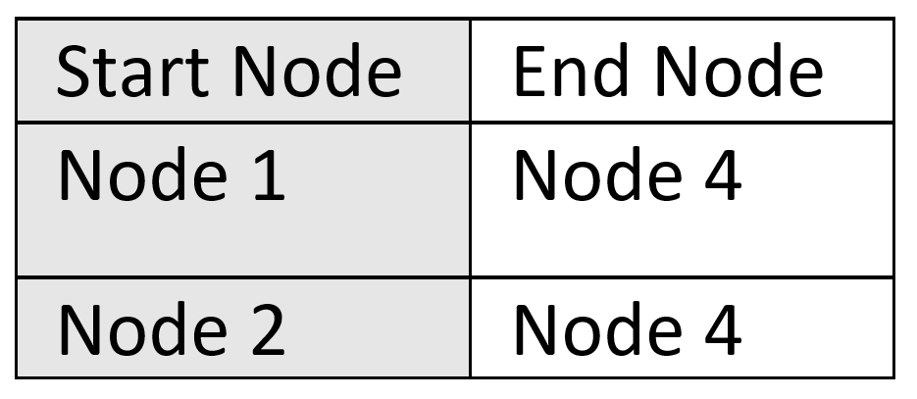
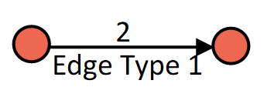
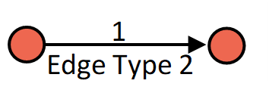
Design: Mini Intra Edges Vis
Purpose/Goals
Provide Quick Summaries of node type connections and edge types
Finding outliers or patterns
Most edge types
Patterns of Node Type Connections
Edge Type and Node Type Patterns
Filter/Selection Bar
Hierarchy
Intra Dependencies
Total: 13
Inter Dependencies

Slide 14
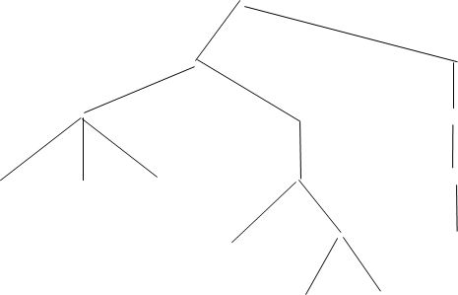
Design: Tree/Icicle Inter Edges
Purpose/Goals
Show Inter Edges
Preserve Hierarchy of Trees
Finding outliers or patterns
Arrow with most inter edges
Node most incoming edges
Node Type patterns to certain trees
Filter/Selection Bar
Hierarchy
Intra Dependencies
Total: 13
Inter Dependencies

Slide 15
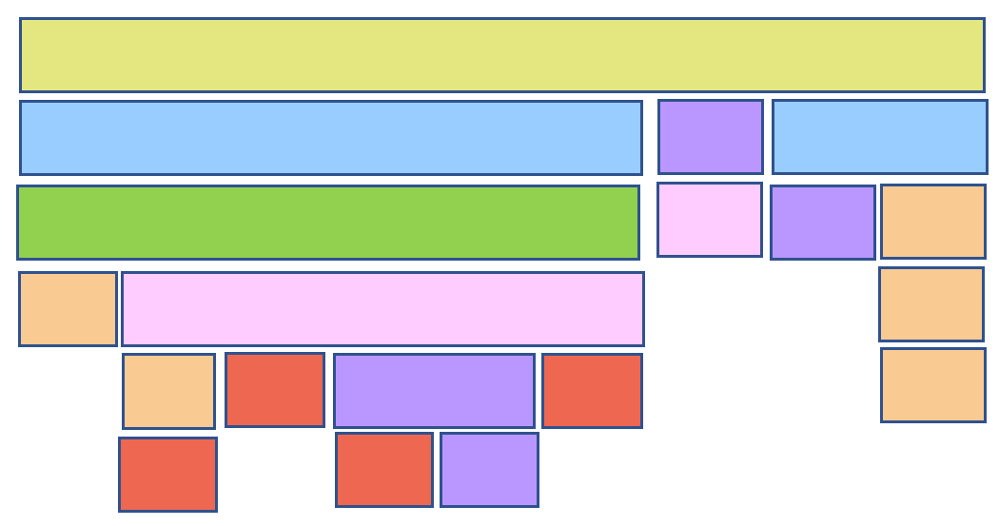
Design: Mini Hierarhcy Vis
Purpose/Goals
Provide quick and easy comparison of two trees hierarchy, size, width, height, and node types
Finding outliers or patterns
Hierarchy patterns among trees
Largest tree (most nodes)
Widest Tree
Filter/Selection Bar
Hierarchy
Intra Dependencies
Total: 13
Inter Dependencies

Slide 16
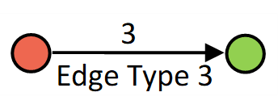

Design: Mini Inter Edges Vis
Purpose/Goals
Provide quick and easy comparison of two trees hierarchy, size, width, height, and node types
Finding outliers or patterns
Hierarchy patterns among trees
Largest tree (most nodes)
Widest Tree
Filter/Selection Bar
Hierarchy
Intra Dependencies
Total: 13
Inter Dependencies
Total: 14
Tree Name #1: 4

Slide 17
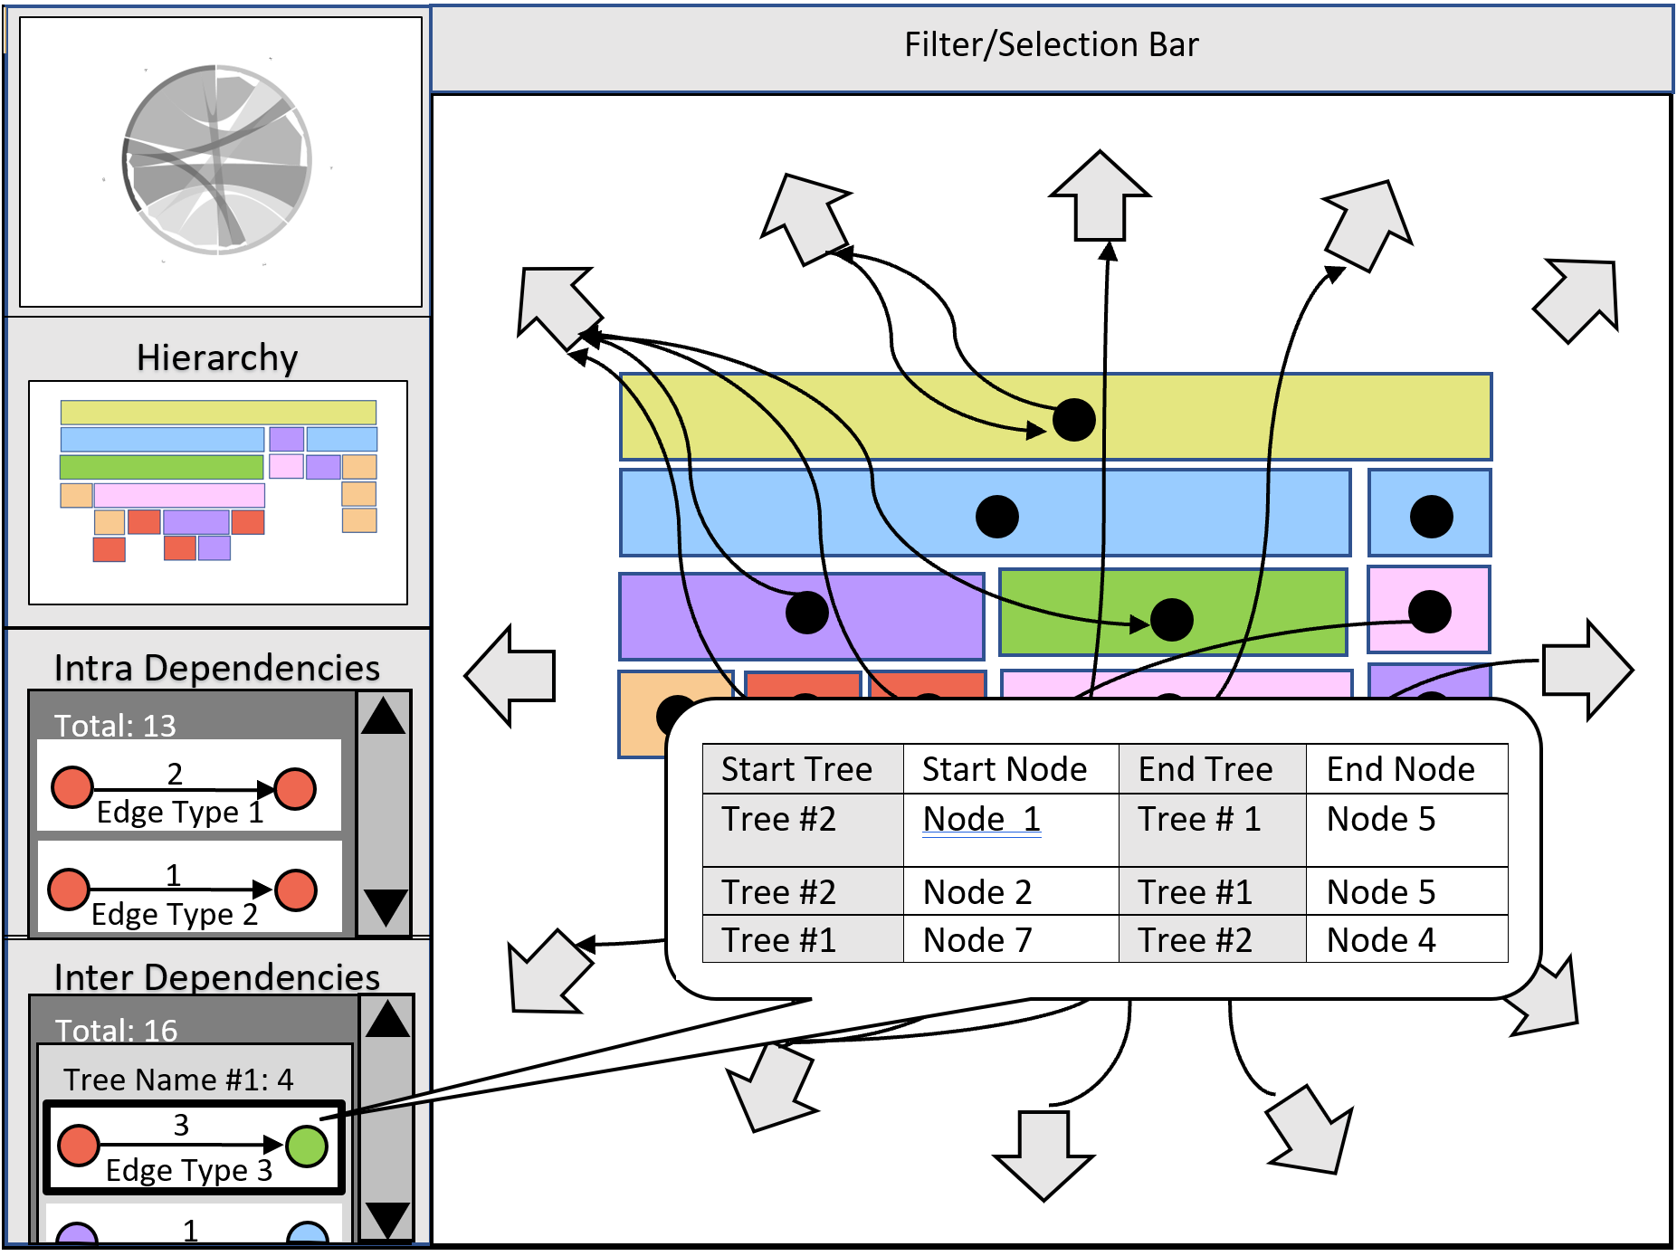
Design: Mini Inter edges Vis
Scrollable Window
Start Node Type, Edge Type, End Node Type
Tooltip, Linked to other vis

Slide 18
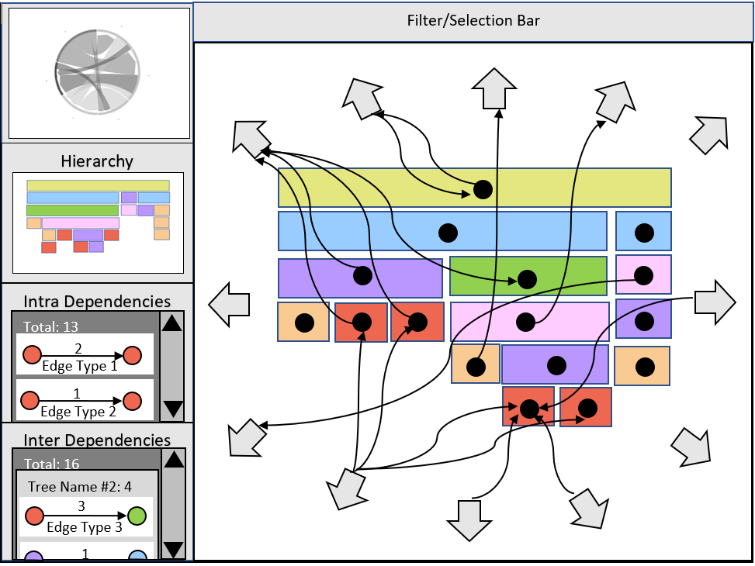
Design: Mini Inter edges Vis
Scrollable Window
Start Node Type, Edge Type, End Node Type
Tooltip, Linked to other vis
Detect Anomalies and Patterns

Slide 19
Design: Features/ ToolBar
Hierarchical/Intra/Inter
Filter
Edge Type
Node Name
Node Type
Tree Name
Incoming/Outgoing
Selection
Node Name
Tree Name
Edge Type
Lasso/Box

Slide 20
Thank You Any Questions?

Slide 21
Considerations/Constraints

